Slide 1
Angular Line of Business Apps Hands On
Deborah Kurata
Jerry Kurata
http://blogs.msmvps.com/deborahk deborahk@insteptech.com jerryk@insteptech.com
Notes:
"An Angular application often displays a view for each of the many business operations including selection, review, and editing. And as soon as you have more than one view, you need a way to navigate between them. This session demonstrates how to define, configure, and navigate Angular routes to display multiple views. First, we look at the available routing frameworks: ngRoute and UI Router, each with their own approach to routing. Then we dive deeper with step-by-step demonstrations of implementing routing based on application state."

Slide 2
Deborah Kurata
Independent Consultant | Developer | Mentor
Web (Angular), .NET
Pluralsight Author
AngularJS Line of Business Applications
Angular Front to Back with Web API
Object-Oriented Programming Fundamentals in C#
Microsoft MVP

Slide 3
Jerry Kurata

Slide 4
Session Materials & Sample Code
https://github.com/DeborahK/angularu2015

Slide 5
Rate Yourself on Angular
New to Angular - no proficiency
Just starting out - limited proficiency
Doing it, not fully understanding it - working proficiency
Been there, done that, can help others - full proficiency

Slide 6

Overview - Part 1
Introduction to Angular
Angular and HTML: Building a View
Data Binding
Angular Code: Building the Module & Controller
Bootstrap: Styling the View

Slide 7
Overview - Part 2
Introduction to SPA
Rule-Based Navigation / Routing
Routing Frameworks (ngRoute/ngNewRouter)
JavaScript Promises
Accessing Data by Calling an HTTP Service
Reusable Code: Building a Service

Slide 8
Part I

Slide 9

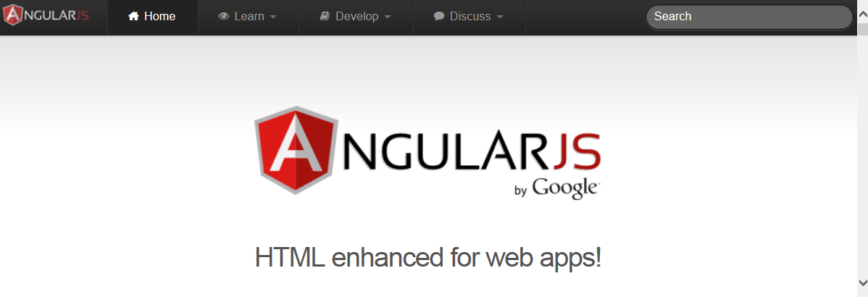
A client-side JavaScript framework for building interactive Web applications
Brings simple/clean back to complex Web apps
Originally developed by Google
Now open source: https://angularjs.org/

Slide 10



Web Server
Web Browser
URL Request (www.mysite.com)
HTML
HTML
Response (Page and Assets)
Java-Script
Java-Script
Notes:
So, how does it work.
There are no "Angular" files per se.
Index.html by convention is the startup page.
It contains link and script tags with the paths to the required assets (HTML templates, JavaScript files, CSS files, etc)

Slide 11
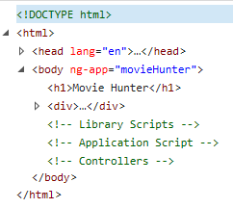
DOM
Document Object Model
Tree structure that defines all of the loaded elements in an HTML document

Slide 12
DEMO: Angular Apps
Notes:
Be sure to show:
Resizing
Filtering
Use F12 tools to show the communication with the server.
Use F12 tools to show the DOM
Leave up the browser to show the visual while going through the code.

Slide 13
Why Angular?
Expressive HTML
Powerful Data Binding
Modularity
Rule-based Navigation
Easily Call HTTP Service
Testable
It's Popular

Slide 14
Movie List View
Expressive HTML
<div ng-controller="MovieListCtrl">
<div>{{title}}</div>
<div>Filter by:</div><input type="text" ng-model="listFilter" />
<div ng-show="listFilter">
<h3>Movies filtered by: {{listFilter}}</h3>
</div>
<table ng-if="movies.length">
<thead>
<tr>
<td><button type="button"
ng-click="toggleImage()">
{{showImage ? "Hide" : "Show"}} Poster
</button></td>
<td>Title</td> <td>Director</td> <td>Release Date</td> <td>Rating</td>
</tr>
</thead>
<tbody>
<tr ng-repeat="movie in movies | filter : {title:listFilter} | orderBy : 'title'">
<td><img ng-show="showImage"
ng-src="{{movie.imageurl}}" title="{{movie.title}}"></td>
<td>{{ movie.title}}</td>
<td>{{ movie.director }}</td>
<td>{{ movie.releaseDate | date }}</td>
<td>{{ movie.mpaa | uppercase}}</td>
</tr>
</tbody>
</table>
</div>

Slide 15
Directives
Expressive HTML
Extend HTML
Apply special behavior to attributes or elements in the HTML
Are simple to define in the HTML
Prefixed with "ng-"
Provide an extensive set of features and capabilities

Slide 16
Directives
<body ng-app="movieHunter">
<table ng-if="movies.length">
<tr ng-repeat="movie in movies | orderBy:'title' ">
<img ng-show="showImage"
ng-src="" />
<button type="button"
ng-click="toggleImage()">Poster
</button>

Slide 17
One Way Data Binding
Powerful Data Binding
View is a projection of the model
When the model changes, the view reflects the change
Binding Expression
{{movie.title}}

Slide 18
One Way Data Binding
<tr ng-repeat="movie in movies | orderBy:'title' ">
<td>
<img ng-show="showImage"
ng-src="{{movie.imageurl}}" />
</td>
<td>
<a>{{movie.title}}</a>
</td>
<td>{{movie.director}}</td>
<td>{{movie.date | date}}</td>
<td>{{movie.mpaa | uppercase}}</td>
</tr>

Slide 19
Two Way Data Binding
Powerful Data Binding
Data in the model and the view are synchronized
Changes to the model are reflected in the view
Changes in the view are reflected in the model
Define using a directive: ng-model
ng-model="listFilter"

Slide 20
Two Way Data Binding
<div>
<div>Filter by:</div>
<div>
<input type="text" ng-model="listFilter" />
</div>
</div>
<div ng-show="listFilter">
<h3>Movies filtered by: {{listFilter}}</h3>
</div>
<tr ng-repeat="movie in movies | orderBy:'title'
| filter : {title : listFilter}">

Slide 21
Directives and Binding
Expressive HTML
Directives
ng-app
ng-if
ng-repeat
ng-show/ng-hide
ng-model
Data Binding
One way binding
{{movie.title}}
Two way binding
ng-model="listFilter"
Powerful Data Binding

Slide 22
Angular Code
Modularity
Write using
JavaScript
TypeScript
Divided into
Modules
Controllers
Services
Notes:
TypeScript
Class-based object-oriented
Strongly typed

Slide 23
Module
Defines an Angular component
Tracks the application code
Tracks all of the dependencies for the application
Keeps the application modularized

Slide 24
Angular Module Method
Setter Method
angular.module("movieHunter", ["ngRoute",
"common.services"]);
Getter Method
angular.module("movieHunter");

Slide 25
Angular Main Module
var app = angular.module("movieHunter",
[]);

Slide 26
Angular Main Module
function () {
var app = angular.module("movieHunter",
[]);
}

Slide 27
Angular Main Module - IIFE
(function () {
var app = angular.module("movieHunter",
[]);
}());

Slide 28
The IIFE JavaScript Pattern
Immediately-Invoked Function Expression
JavaScript var declarations have global scope
JavaScript variables and functions defined within a function have local scope
(function () {
// Code here
}());

Slide 29
Module
Modularity
One "main" module for the application
Any number of additional modules
Group related functionality
Define reusable common code

Slide 30
Controller
Defines the Model
Movies
Implements Methods
Hide/Show Images

Slide 31
View, Controller, and $scope
Angular Application (movieHunter)
movieListView
MovieListCtrl
<div ng-controller=
"MovieListCtrl">
$scope
Directives & Bindings
Model
</div>
Methods

Slide 32
Angular Controller
(function () {
"use strict";
angular
.module("movieHunter")
.controller("MovieListCtrl",
["$scope",
MovieListCtrl]);
function MovieListCtrl($scope) {
$scope.movies = [];
$scope.title = "Search by Movie Title";
$scope.showImage = false;
$scope.toggleImage = function () {
$scope.showImage = !$scope.showImage;
};
}());

Slide 33
Angular "Controller As" Syntax
(function () {
"use strict";
angular
.module("movieHunter")
.controller("MovieListCtrl",
["$scope",
MovieListCtrl]);
function MovieListCtrl($scope) {
$scope.movies = [];
$scope.title = "Search by Movie Title";
$scope.showImage = false;
$scope.toggleImage = function () {
$scope.showImage = !$scope.showImage;
};
}());

Slide 34
Angular "Controller As" Syntax
(function () {
"use strict";
angular
.module("movieHunter")
.controller("MovieListCtrl",
[MovieListCtrl]);
function MovieListCtrl() {
$scope.movies = [];
$scope.title = "Search by Movie Title";
$scope.showImage = false;
$scope.toggleImage = function () {
$scope.showImage = !$scope.showImage;
};
}());

Slide 35
Angular "Controller As" Syntax
(function () {
"use strict";
angular
.module("movieHunter")
.controller("MovieListCtrl",
[MovieListCtrl]);
function MovieListCtrl() {
var vm = this;
$scope.movies = [];
$scope.title = "Search by Movie Title";
$scope.showImage = false;
$scope.toggleImage = function () {
$scope.showImage = !$scope.showImage;
};
}());

Slide 36
Angular "Controller As" Syntax
(function () {
"use strict";
angular
.module("movieHunter")
.controller("MovieListCtrl",
[MovieListCtrl]);
function MovieListCtrl() {
var vm = this;
vm.movies = [];
vm.title = "Search by Movie Title";
vm.showImage = false;
vm.toggleImage = function () {
vm.showImage = !vm.showImage;
};
}());

Slide 37
View "Controller As" Syntax
<div ng-controller="MovieListCtrl">
<div>{{title}}</div>
<div>Filter by:</div><input type="text" ng-model="listFilter" />
<div ng-show="listFilter">
<h3>Movies filtered by: {{listFilter}}</h3>
</div>
<table ng-if="movies.length">
<thead>
<tr>
<td><button type="button"
ng-click="toggleImage()">
{{showImage ? "Hide" : "Show"}} Poster
</button></td>
<td>Title</td> <td>Director</td> <td>Release Date</td> <td>Rating</td>
</tr>
</thead>
<tbody>
<tr ng-repeat="movie in movies | filter : {title:listFilter} | orderBy : 'title'">
<td><img ng-show="showImage"
ng-src="{{movie.imageurl}}" title="{{movie.title}}"></td>
<td>{{ movie.title}}</td>
<td>{{ movie.director }}</td>
<td>{{ movie.releaseDate | date }}</td>
<td>{{ movie.mpaa | uppercase}}</td>
</tr>
</tbody>
</table>
</div>

Slide 38
View "Controller As" Syntax
<div ng-controller="MovieListCtrl as vm">
<div>{{title}}</div>
<div>Filter by:</div><input type="text" ng-model="listFilter" />
<div ng-show="listFilter">
<h3>Movies filtered by: {{listFilter}}</h3>
</div>
<table ng-if="movies.length">
<thead>
<tr>
<td><button type="button"
ng-click="toggleImage()">
{{showImage ? "Hide" : "Show"}} Poster
</button></td>
<td>Title</td> <td>Director</td> <td>Release Date</td> <td>Rating</td>
</tr>
</thead>
<tbody>
<tr ng-repeat="movie in movies | filter : {title:listFilter} | orderBy : 'title'">
<td><img ng-show="showImage"
ng-src="{{movie.imageurl}}" title="{{movie.title}}"></td>
<td>{{ movie.title}}</td>
<td>{{ movie.director }}</td>
<td>{{ movie.releaseDate | date }}</td>
<td>{{ movie.mpaa | uppercase}}</td>
</tr>
</tbody>
</table>
</div>
Notes:
ALIAS

Slide 39
View "Controller As" Syntax
<div ng-controller="MovieListCtrl as vm">
<div>{{vm.title}}</div>
<div>Filter by:</div><input type="text" ng-model="listFilter" />
<div ng-show="listFilter">
<h3>Movies filtered by: {{listFilter}}</h3>
</div>
<table ng-if="vm.movies.length">
<thead>
<tr>
<td><button type="button"
ng-click="vm.toggleImage()">
{{vm.showImage ? "Hide" : "Show"}} Poster
</button></td>
<td>Title</td> <td>Director</td> <td>Release Date</td> <td>Rating</td>
</tr>
</thead>
<tbody>
<tr ng-repeat="movie in vm.movies | filter : {title:listFilter} | orderBy : 'title'">
<td><img ng-show="vm.showImage"
ng-src="{{movie.imageurl}}" title="{{movie.title}}"></td>
<td>{{ movie.title}}</td>
<td>{{ movie.director }}</td>
<td>{{ movie.releaseDate | date }}</td>
<td>{{ movie.mpaa | uppercase}}</td>
</tr>
</tbody>
</table>
</div>

Slide 40
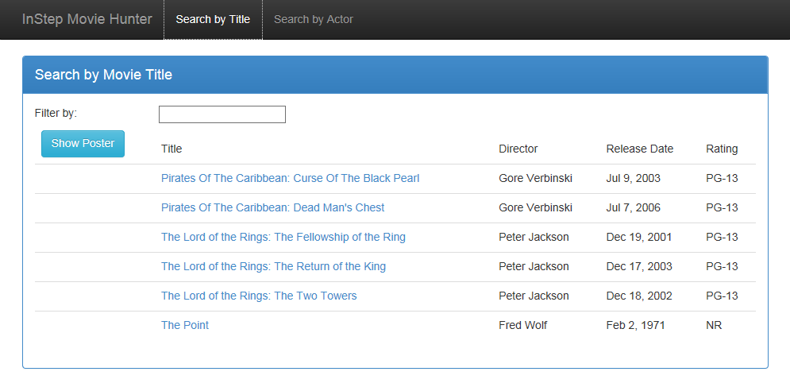
Sample Application

Slide 41
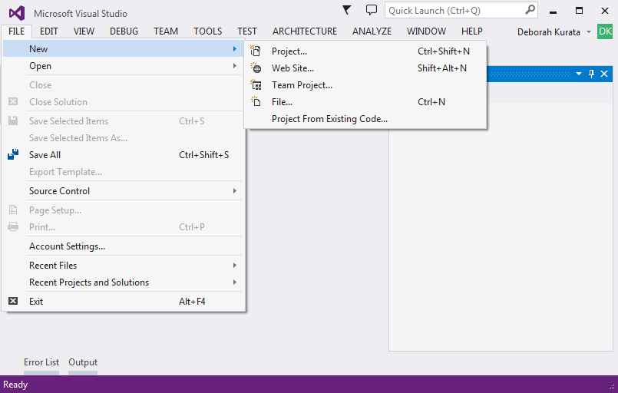
Creating an Angular Project

Slide 42
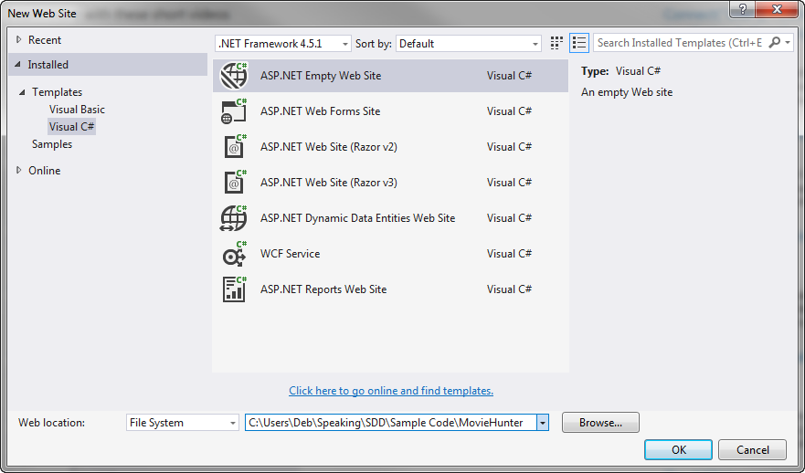
Selecting a Template

Slide 43
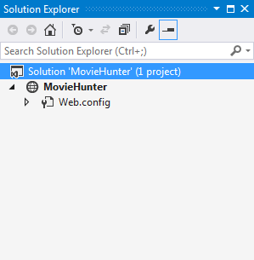
Generated Solution

Slide 44
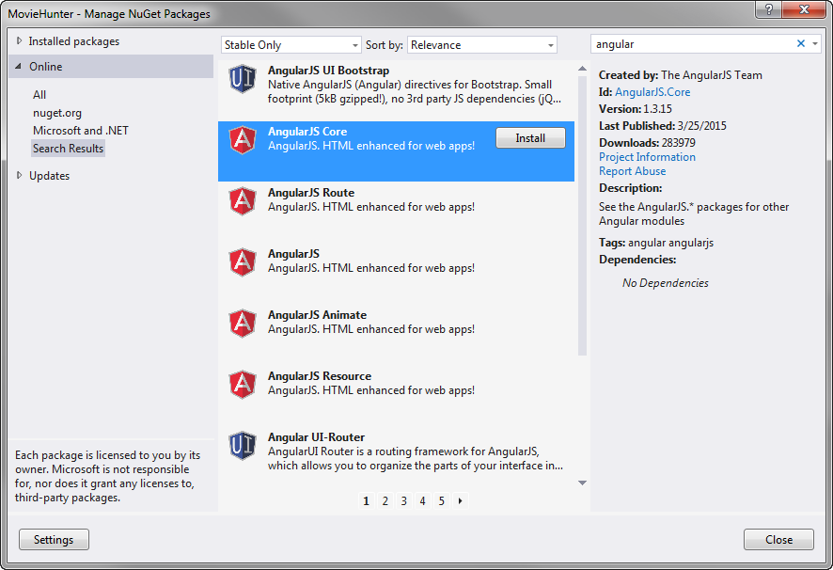
NuGet Package Manager

Slide 45
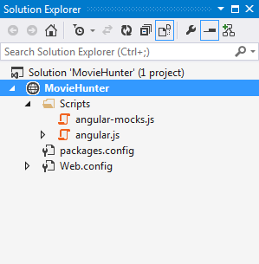
Solution Explorer

Slide 46
app.js (movieHunter)
index.html
movieListView.html
<head>
<link …/>
</head>
<body ng-app=
"movieHunter">
<div ng-controller=
"MovieListCtrl as vm">
...
</div>
movieListCtrl.js (MovieListCtrl)
[menu code here]
<ng-include=
"'movieListView.html'">
Model
<script …/>
</body>
Methods

Slide 47
DEMO: Angular Code So Far

Slide 48
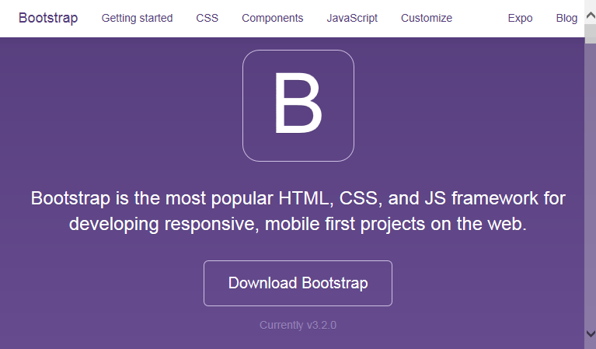
Bootstrap
Framework for prettifying Web pages
Developed by Twitter
http://getbootstrap.com/
Large third party community
Notes:
Responsive
Browser Differences

Slide 49
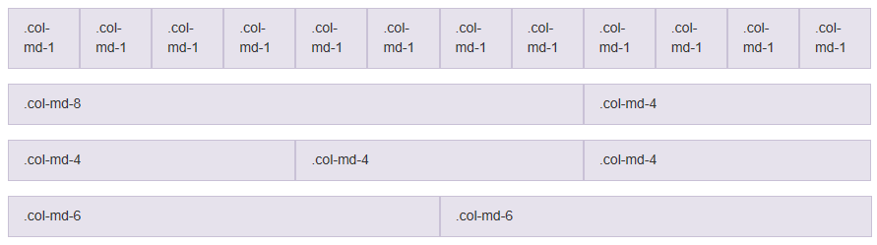
Bootstrap Grid System
Notes:
Responsive
Browser Differences

Slide 50
DEMO: Bootstrap

Slide 51
Take Away
Expressive HTML
Powerful Data Binding
Modularity
Easily Call HTTP Service
Rule-based Navigation

Slide 52
Thank You!
@deborahkurata
deborahk@insteptech.com
http://blogs.msmvps.com/deborahk
https://github.com/DeborahK/SDD2015

Slide 53
Rate Yourself on Routing
New to Angular - no proficiency
Just starting out - limited proficiency
Doing it but not fully understanding it - working proficiency
Been there, done that, can help others - full proficiency

Slide 54

Overview
SPA
Routing
Routing Frameworks
ngRoute
ngNewRouter

Slide 55
Demo: Angular in Action
Notes:
Product Management
Point out how the navigation works.
And how the nested views look.
2) Movie Hunter
Point out the simple navigation.
This is the code we will look at in this session

Slide 56
SPA
Single Page Application
Only one page?
Only one full HTML page
All other pages are HTML fragments called templates
And are displayed within the one HTML page
Goals:
Enhance user experience
Reduce round tripping
Notes:
"Template" or sometimes "layout template"

Slide 57

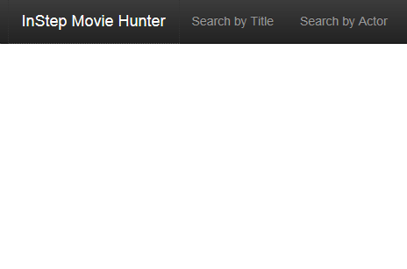
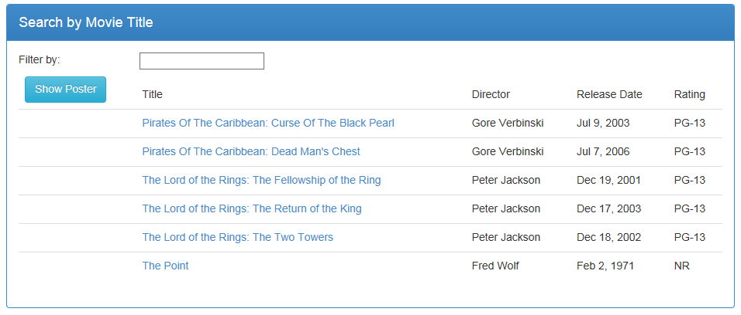
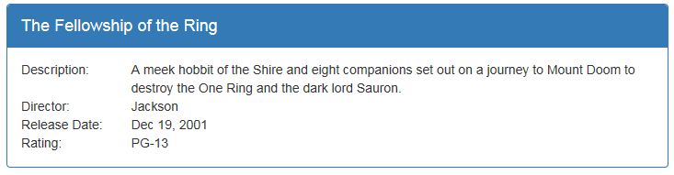
Multiple Views
Notes:
Most Web applications are more than one page.
- Define each view in its own html file.
Define the header, menu, footer in the index.html.
Define the ng-view directive in the location in the HTML where the views should appear.

Slide 58
Routing
Technique for navigating between views
Each route represents a specific view
Activating a route navigates to that view
Routes defined by rules

Slide 59
Routing Frameworks
ngRoute
UI Router
ngNewRouter
Notes:
ngRoute
Is the original routing framework provided by Angular.
It provides for simple, straight-forward routes.
UI Router
Is a third-party routing package.
It has more advanced features than ngRoute including
Nested views, as we saw with the tab pages in the Product Management application we looked at.
ngNewRouter
Is the new router that is coming out in Angular 1.4
And is expected to be the router for Angular 2.0.
It provides the ease of use of ngRoute
With many of the more advanced features from UI Router.
Though the syntax will be slightly different, the concepts are the same for each of the three frameworks

Slide 60
ngRoute
Available from
https://angularjs.org/
angular-route.js
Based on
URL fragment identifiers
Each route has
URL fragment identifier
View template
Optional Controller
Angular Web Site
http://localhost:64492/index.html#/searchByTitle

Slide 61
UI Router
Available from
https://github.com/angular-ui/ui-router
angular-ui-router.js
Based on
Application states
Each state has
Optional URL fragment identifier
View template
Optional Controller
Third-party Angular UI Library

Slide 62
ngNewRouter
Available from
https://github.com/angular/router
Router.es5.js
Based on
URL fragment identifiers
Each route has
URL fragment identifier (path)
Component
Angular 1.4
http://localhost:64492/index.html#/searchByTitle

Slide 63
ngRoute
https://docs.angularjs.org/api/ngRoute
Notes:
We'll first look at the Angular module: ngRoute.

Slide 64
Site Map
Welcome Page
Movie Detail
Movie List
Menu
Movie Edit
Notes:
An easy way to picture the routing is to look at a site map.

Slide 65
Routes
Welcome Page
/showDetail/3
Movie Detail
/
/searchByTitle
Movie List
/editMovie/3
Menu
Movie Edit
/editMovie/0
Notes:
Each view in the map can then be associated with a named route.

Slide 66
Routing URL Fragments
<mysite>/index.html#/
<mysite>/index.html#/searchByTitle
<mysite>/index.html#/showDetail/3
Notes:
Define the ng-view directive in the location in the HTML where the views should appear.
ng-viewport in the new Angular router.

Slide 67
ngRoute: index.html
<div class="container">
<div ng-view></div>
</div>
Notes:
- By convention, the "single page" of the application is defined in index.html.
- In the index.html file, define the header, menu bar, and footer.
- And use the ng-view directive to identify where the HTML templates for the views should appear.
ng-view includes the rendered template of the current route into the main layout.
Every time the route changes, the included view changes with it according to the route configuration.

Slide 68
Routes
Welcome Page
/showDetail/3
Movie Detail
/
/searchByTitle
Movie List
Menu
Movie Edit
/editMovie/3

Slide 69
ngRoute: app.js
var app = angular.module("movieHunter", ["ngRoute"]);
app.config(['$routeProvider',
function ($routeProvider) {
$routeProvider
.when("/", {
templateUrl: "app/welcomeView.html"
})
.when("/searchByTitle", {
templateUrl: "app/movies/movieListView.html",
controller: "MovieListCtrl as vm"
})
.when("/showDetail/:movieId", {
templateUrl: "app/movies/movieDetailView.html",
controller: "MovieDetailCtrl as vm"
})
.otherwise("/");
}]);
Notes:
$routeProvider is the provider for the $route service.
Providers create and provide instances of services and expose configuration APIs.
Providers can only be injected into config functions.
Everyone know what "controller as" means?
NOTE: I cut the edit view off of this code so it would fit in the slide.

Slide 70
Navigation
Anchor tags
Link to the appropriate route
<a ng-href="#searchByTitle">
$location service
$location.path("/searchByTitle");
Notes:
To navigate to a view, activate its route.

Slide 71
ngRoute: index.html
<div class="navbar-collapse collapse">
<ul class="nav navbar-nav">
<li>
<a ng-href="#searchByTitle">Search by Title</a>
</li>
<li>
<a ng-href="#editMovie/0">
<i class="glyphicon glyphicon-plus"></i>
Add Movie
</a>
</li>
</ul>
</div>

Slide 72
ngRoute: movieDetailView.html
<div class="panel-footer">
<a class="btn btn-default"
ng-href="#searchByTitle"
style="width:80px">
<i class="glyphicon glyphicon-chevron-left"></i>
Back
</a>
<a class="btn btn-primary"
ng-href="#editMovie/{{vm.movie.movieId}}"
style="width:80px;margin-left:10px">
Edit
</a>
</div>

Slide 73
Demo: ngRoute
Notes:
Show the app.js file.
Show the index.html file
Show the movieDetailView.html file.
Show the movieEditView.html file.

Slide 74
ngNewRouter
https://github.com/angular/router
https://angular.io/
Notes:
Now let's take a quick look at ngNewRouter
- This is the router coming out in Angular 1.4 and used in Angular 2.0

Slide 75
ngNewRouter: index.html
<div class="container">
<div ng-viewport></div>
</div>
Notes:
ng-viewport directive instead of ng-view
Defines where the content is displayed

Slide 76
ngNewRouter : app.js
var app = angular.module("movieHunter", ["ngNewRouter"]);
app.controller('AppController', ['$router', AppController]);
function AppController ($router) {
$router.Config([
{ path: '/', component: 'welcome' },
{ path: '/searchByTitle', component: 'movieList' },
{ path: '/showDetail/:movieId', component: 'movieDetail' },
{ path: '/editMovie/:movieId', component: 'movieEdit' }
]);
}
Notes:
Things to notice here:
Dependency on ngNewRouter
We define a controller instead of using the .config.
The router config takes an array of pairings (path and component)
The paths map to routable components
The route is a named component with an aliased function
NOTE: The new router enforces the "controller as" syntax!

Slide 77
Routable Component in 1.4+
Defined by the directory structure
Or configure with
$componentLoader
components/
welcome/ welcome.html
movieList/ movieList.html movieList.js
movieEdit/ movieEdit.html movieEdit.js
Notes:
Or configure in the $componentLoader service
Best practice: Define each component in a separate module.
Once the Angular team implements lazy loading, it will be possible to delay loading of the module until it is requested

Slide 78
ngNewRouter: movieDetailView.html
<div class="panel-footer">
<a class="btn btn-default"
ng-link="movieList"
style="width:80px">
<i class="glyphicon glyphicon-chevron-left"></i>
Back
</a>
<a class="btn btn-primary"
ng-link="movieEdit({movieId: vm.movie.movieId})"
style="width:80px;margin-left:10px">
Edit
</a>
</div>
Notes:
ng-link directive navigates to the route component.
Link to the *component* not the path.
Notice the difference in syntax for the link to movieEdit.
This uses a function expression.
The movieId is passed as an argument.

Slide 79
Multiple Viewports: Sibling Components
<div ng-viewport="master"></div>
<div ng-viewport="detail"></div>
var app = angular.module("movieHunter", ["ngNewRouter"]);
app.controller('AppController', ['$router', AppController]);
function AppController($router) {
$router.config([
{ path: '/showDetail/:movieId',
component:
master: 'movieList',
detail: 'movieDetail' }
]);
}
Notes:
Multiple viewports allows us to display multiple views within the index.html file.
Other examples:
- Separating application header from the menu

Slide 80
Child Views
<div class="panel-body">
<div class="wizard">
<a ng-link="movie">
Movie Details
</a>
<a ng-link="actors">
Actors
</a>
<a ng-link="tags">
Search Tags
</a>
</div>
<div ng-viewport></div>
</div>
Notes:
Add a ng-viewport inside a view.

Slide 81
Lifecycle Hooks
canActivate
Before switch to component
Example: authorization
MovieEditController.prototype.canActivate = function() { return this.user.isAdmin; };
activate
Before navigation finishes
Example: retrieve data
MovieEditController.prototype.activate = function() { return movieResource.get(…); };
Notes:
Lifecycle hooks allow you to control each state of a route navigation.
Use "activate" for "resolve" features??

Slide 82
Lifecycle Hooks (cont)
canDeactivate
Before switch to component
Example: ensure data is saved
MovieEditController.prototype.canDeactivate = function() { return this.isDataSaved; };
deactivate
Before switch to component
Example: clean up work
MovieEditController.prototype.deactivate = function() { return ...; };

Slide 83
Lifecycle Hooks Sequence
canDeactivate
canActivate
deactivate
activate
Notes:
Lifecycle hooks allow you to control each state of a route navigation.
Use canActivate for authorization features
Use "activate" for "resolve" features??
Use canDeactivate to ensure data is saved.

Slide 84
Demo: ngNewRouter
https://github.com/angular/router/tree/master/examples/angular-1/wizard
Notes:
Show directory structure
Show each page.
Show canActivate

Slide 85
Which to Use?
Use ngNewRouter
If you can use Angular 1.4
And are OK with the directory structure (or $componentLoader service)
Use ngRoute
If app is <1.4
And only need simple routing
Use ui-Router
If app is <1.4
And you need complex routing (nesting, etc)

Slide 86
Thank You!
@deborahkurata
deborahk@insteptech.com
http://blogs.msmvps.com/deborahk
https://github.com/DeborahK/ab2015

